Slide 1
Section 4.1 Extreme Values of Functions
In this chapter we use derivatives to find extreme values of functions, to determine and analyze the shapes of graphs, and to find numerically where a function equals zero. We also introduce the idea of recovering a function from its derivative. The key to many of these applications is the Mean Value Theorem, which paves the way to integral calculus in Chapter 5.
In the first section, we will learn how to locate and identify extreme (maximum or minimum) values of a function from its derivative.

Slide 2
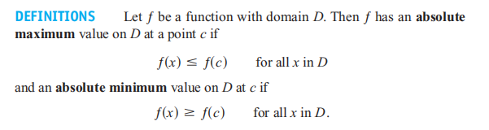
Maximum and minimum values are called extreme values of the function ƒ. Absolute maxima or minima are also referred to as global maxima or minima.

Slide 3
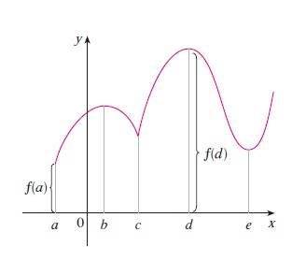
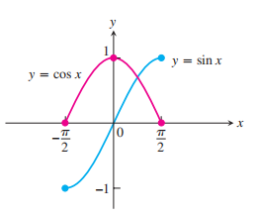

Slide 4
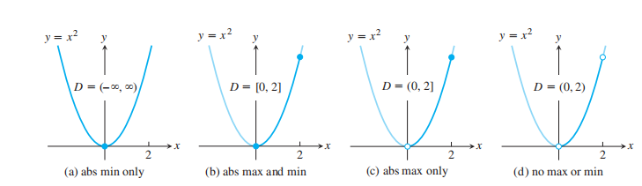
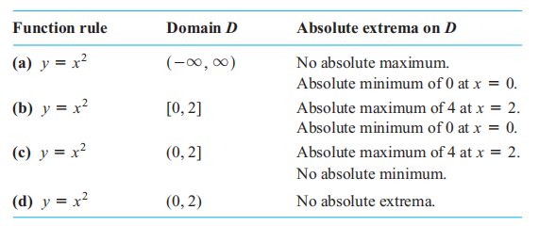
EXAMPLE 1

Slide 5
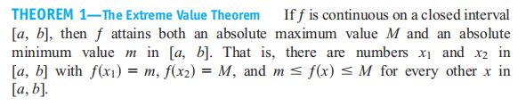
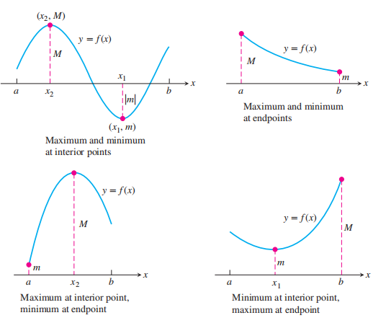

Slide 6
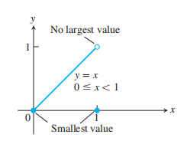

The requirements in Theorem 1 that the interval be closed and finite, and that the function be continuous, are key ingredients. Without them, the conclusion of the theorem need not hold. Example 1 shows that an absolute extreme value may not exist if the interval fails to be both closed and finite. Figure 4.4 shows that the continuity requirement can not be omitted.
The function
is continuous at every point of [0, 1]
except yet its graph over [0, 1] does not have a highest point.

Slide 7
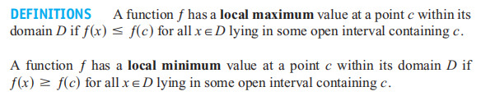
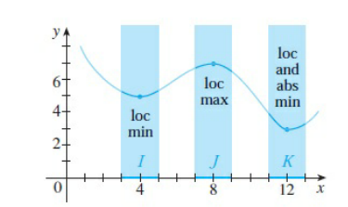
Local (Relative) Extreme Values
Local extrema are also called relative extrema

Slide 8
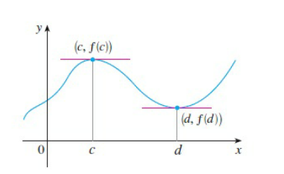
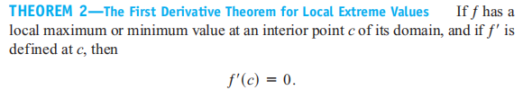
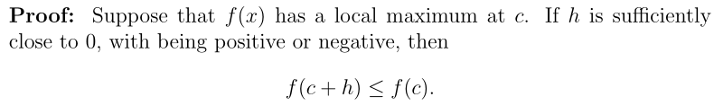
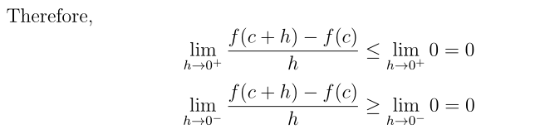

Slide 9
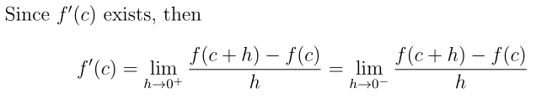
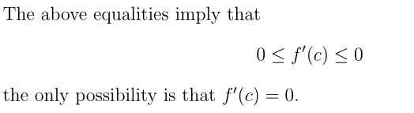

Slide 10
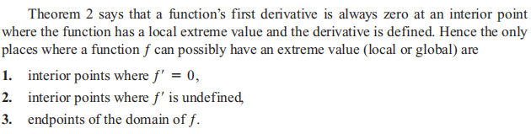

Slide 11
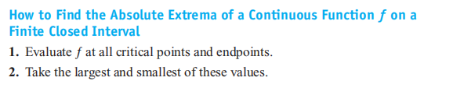

Slide 12
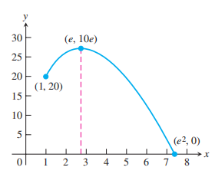

Slide 13
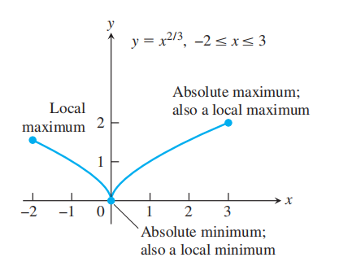

Slide 14
Homework: P228: 24, 50

